Slide 1

Train the Trainer: Overcoming Common Learner Challenges
Facilitators:
Jessa Armstrong
Initiate Product Manager
Northern Initiatives Business Coaches:
Cailin Kelly, Jody Lindberg & Mary Bickel
Notes:
Technical Assistance Team Leaders, and Managers
Welcome!
Your Facilitators for today:
Chris Wendel: Initiate Program Manger, has served as a Coach, Trainer, and Lender with NI since 2012
Jessa Armstrong: Initiate Associate Product Manager since 2020

Slide 2
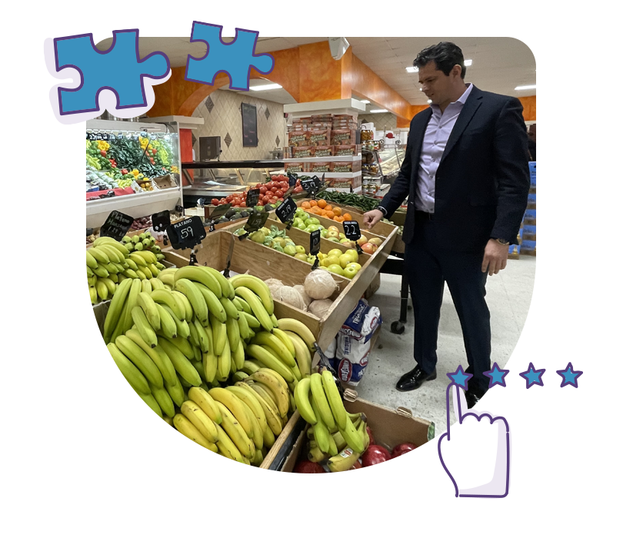
About Today’s Session
We are going to breaking down three potential challenges you may come across:
Technology barriers facing rural and small business owners
Experiencing stress, burnout, or other mental health challenges
Coming from diverse cultural backgrounds and bringing different communication styles, perspectives, and business practices
Our presenters today are our Northern Initiatives coaches, Jody Lindberg, Cailin Kelly and Mary Bickel. For each topic, they will cover:
What to watch for
Ideas on how to adjust your approach
A real life example of it playing out with a client

Slide 3
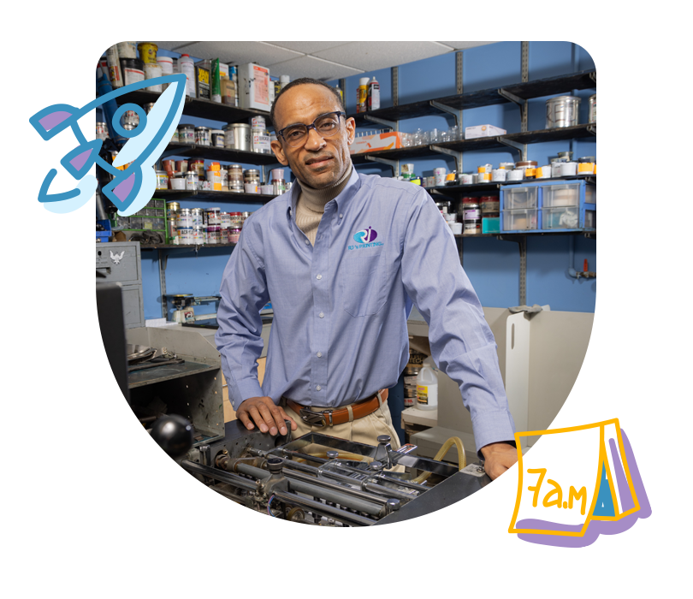
Technology barriers facing rural &
small business owners
What does this look like? / What to watch for:
Device Access and/or Internet Access
Digital Skills
Business Technology Adoption
Barriers
Business Owner Characteristics
Ideas for adjusting:
Learn the needs of the business owner
Ask questions
Look for signs
Identify the specific challenge
Meet them where they are
Make technology practical
Example Client:
Specific Challenge: Mobile only for financial management
How you recognized it: Reconciling, accounts not balancing
How you are working with them now: Financial literacy, using Initiate financial templates to grow understanding and comfort level to transition to financial software

Slide 4

Stress, burnout & mental health challenges
What does this look like? / What to watch for:
Changes in communication:
  Silence that could be agreement, confusion, or discomfort.
  OR increased communication - looking for reassurance, or directing anger/blame at you (coach, organization, lender, etc).
Financial Distress
  Late or missed tax filings
  New loans (Merchant Cash Advance, etc.)
  Credit score reduction
Ideas for adjusting:
Risk assessment (immediate danger) & organizational policy
Develop a support resource list
Regular check-ins and meetings
Example Client:
Specific Challenge: Merchant Cash Advance Collections (tip of the iceberg)
How you recognized it: Urgent request for loan modification/deferral
How you are working with them now: Emergency action plan

Slide 5
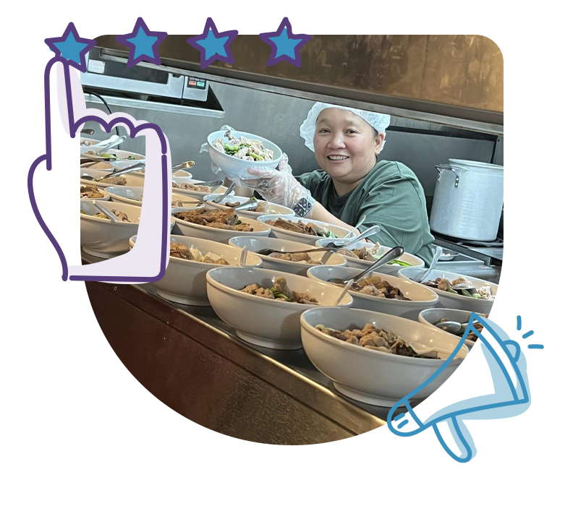
Diverse cultural backgrounds & communication styles
What does this look like? / What to watch for:
Cultural/regional challenges
  Changes in weather patterns regionally
  Major shifts in laws and regulations due to shifting political climates
  Differences in communication preferences and values
Ideas for adjusting:
Meeting them where they are at and with an open, curious mind
when/where they are comfortable - in person, phone, zoom, etc.
Scheduling length of time and communication that works for them
Example Client:
Specific Challenge - Kurdish Restaurateur who spoke little English
Realized language barrier after attempting communication multiple times without luck
Option to meet with them and a trusted family member
Notes:
What does this look like? / What to watch for:
Cultural/regional challenges:
Severe weather events - U.P. warmer weather challenge, (snow-mobile businesses facing decline and other snow and winter recreation businesses ) smoke causing low business outside, extreme and quick weather changes - prep with generators etc.
Cities where ICE has presence - giving people space and patience, and hearing their main concerns/emotions - understanding that communicating certain things over email may worry them. Build trust before pushing change. Have cultural humility and ask yourself often how much of your approach is coming from your own cultural expectations.
Differences in communication and work styles - some prefer quick in person, some prefer long web meeting with agendas.
Ideas for adjusting:
Meeting them where they are at and with an open, curious mind - The main thing is to not make assumptions, but to ask good questions and listen well so that you can adjust as needed. i.e. meeting in person and discussing sensitive details that way, rather than in writing over text or email.
Ask open ended questions about their main fears and concerns as well as their top priorities and values. this helps the customers think through these possible challenges, and allows YOU to hear what solutions they may have already come up with and to gain more trust by having them share their concerns. Another important step in regards to things like major weather challenges, and legal political issues, is to tap into community resources, like the chamber and neighboring businesses to find out if they have similar issues and what they have done about it.
LEARN Their main values - is it organization and punctuality, is it community and family, or is it profit building and enterprising? Are they extremely concerned about making the most of their limited time, or do they like to chit chat and get to know people before diving right into business discussions.
when/where they are comfortable - in person, phone, zoom, etc.
Scheduling length of time and communication that works for them
Example Client:
Specific Challenge - Kurdish Restaurant owner who spoke little English
Realized language barrier after attempting communication multiple times without luck
Option to meet with them and a trusted family member (This also happened at a Mexican grocery store)

Slide 6
Initiate Updates & Training Opportunities
Platform Updates:
Remove Option to Add Account information: Platform Admin can now toggle off the option for users to add any business or demographic information to their account.
Improved search functionality: When using the search bar it will be able to better detect misspelling in keywords and find related resources.
Upcoming Resources
Why Processes Matter: Getting Started with SOPs
Who Does What? Knowing and Owning Responsibilities
What Matters Most? Deciding What to Document First
Writing SOPs Your Team Will Actually Use
Turning SOPs into Daily Habits
Keeping Processes Working Through Review and Team Ownership
Training Opportunities
Initiate Refresher Training: September 24th | 1-3 pm ET
Train the Trainer: Job Quality - October 1st | 1-2 pm ET

