Slide 1


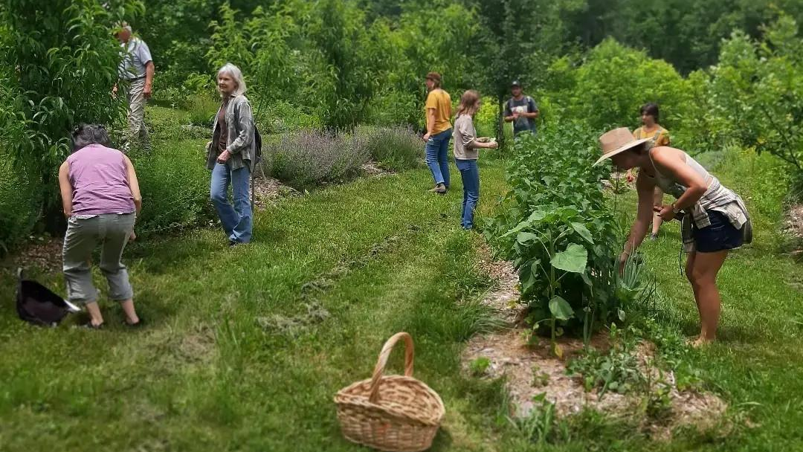
Artificial Intelligence
&
Business Support
Sylvatica Forest Farm,
Rockcastle County, KY
Notes:
Bailey

Slide 2



About Mountain Association
Established in 1976
We are a Community Development Financial Institution (CDFI) and our goal is to invests in people and places in order to build to a new economy in Eastern Kentucky.
Our Programs
- Lending team makes loans to existing and startup businesses and organization
- Business Support program connects businesses and nonprofits to resources
- Energy experts help businesses, organizations and public agencies find much-needed cost savings.
-Strategic Initiatives supports community development work in the region
Notes:
Bailey

Slide 3
Overview
What it is: AI is a computer technology that can learn, think, and do tasks that people usually do. AI systems can study information, recognize patterns, and improve over time.
How it works: Al studies large amounts of information, like words, pictures, and numbers, to find patterns and make predictions.
Where you see it: ChatGPT, CoPilot, Google & Bing searches, Quickbooks. You're already using Al everyday.
Resources:
AI | What It Is & How You Can Use It
Notes:
You're already using Al everyday. It's in navigation apps like Google Maps, spam filters in your
email, and virtual assistants like Siri or Alexa. Al helps power the chatbots you interact with on
websites, recommend products online, or even detect fraud in banking. As Al continues to
grow, it is being used in many fields such as healthcare, education, and business to solve
problems and make tasks easier and faster.

Slide 4
KEY TAKEAWAY
AI works best as a processing tool that can help you succeed, if you invest your time.
Clients are more likely to succeed when they:
Have a concrete goal
Provide context
Protect sensitive data
Review & edit the results
Notes:
This section covers how AI is being used by businesses in our region, where it falls short, how we integrate it into our work through LivePlan, and structured guidance on best uses, common misuses, professional TA applications, and loan preparation.

Slide 5
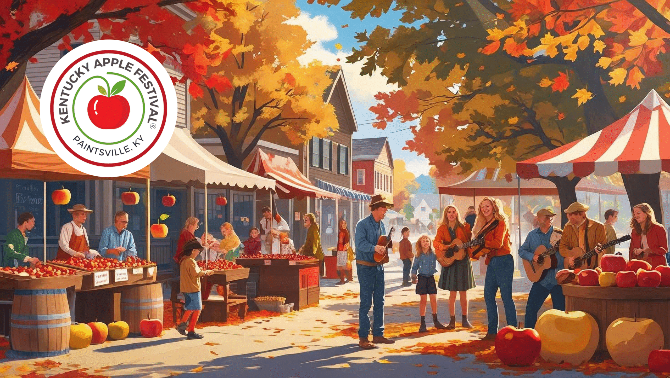

When AI Goes Wrong
Common Pitfalls:
The AI “look”
Garbage in, garbage out (“slop”)
Too much trust & not enough knowledge
Notes:
How businesses misuse AI:
Bad marketing: posters, images with that obvious AI "look" — tacky—they don't look or sound like something the business owner would produce. They're not authentic. Importantly, they generate negative feedback on social media (quality, ethics, authenticity). Graphic designers are small business owners, too. Photographers, gamers, anti-data-center folks.
Words/language/narrative not matching someone’s voice can be very off-putting.
Jess Stevens – refuse to do AI project with client
How to counteract this:
Train your AI to sound like you (Julie Rea)
Hire someone to do the work
Do it yourself and focus your AI energy on better time savers.

Slide 6
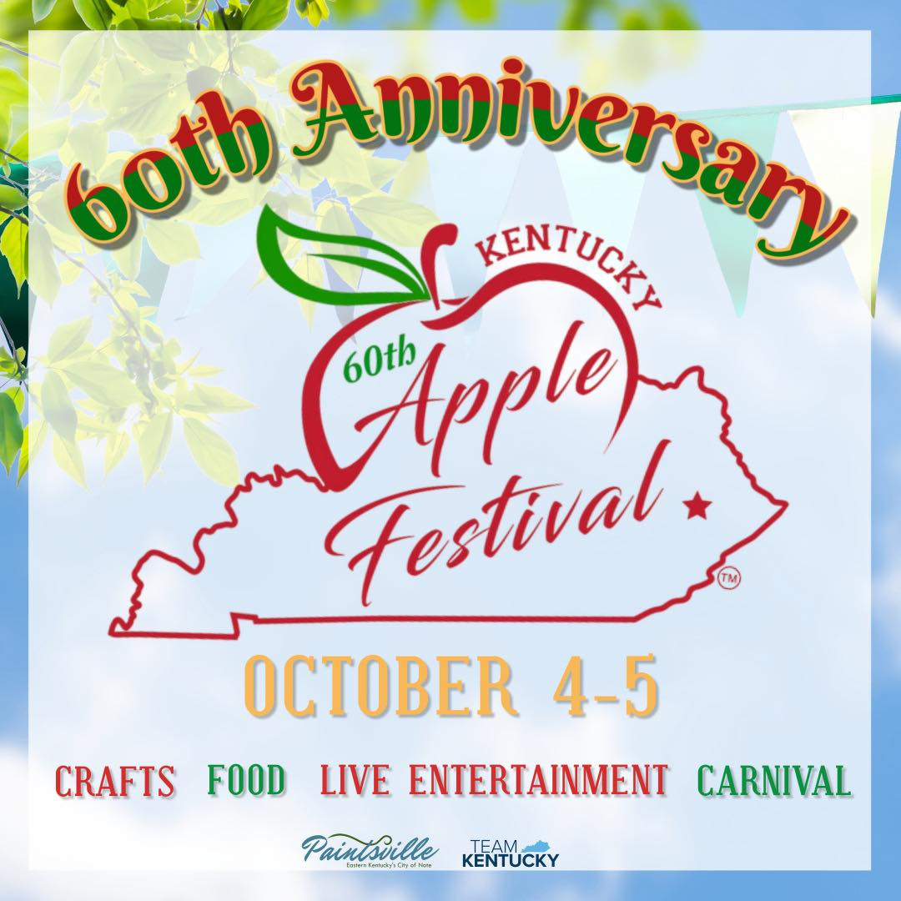
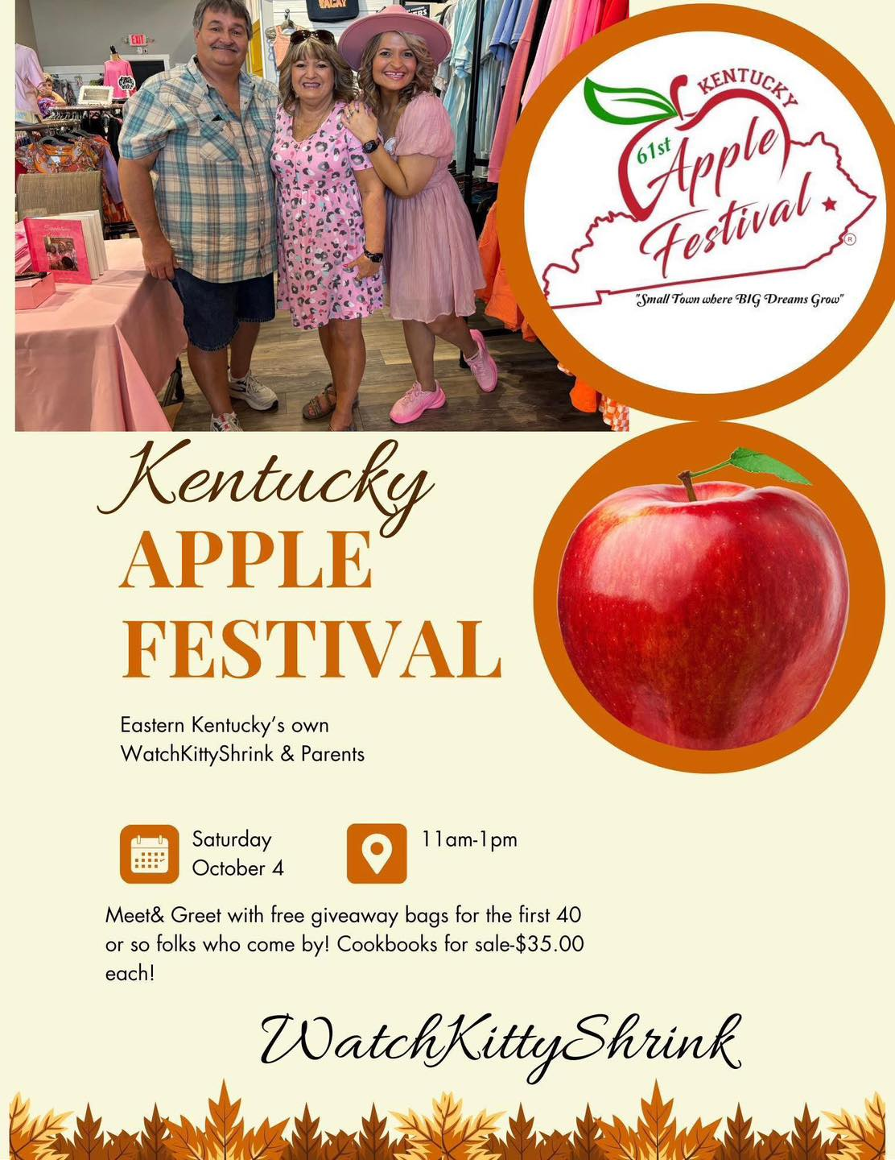
When AI Goes Wrong
Notes:
Imagine the difference with a loan application—business plan, specifically.

Slide 7
Recommend Uses for Small Businesses
Business Need | What AI Can Do
Marketing | Write ads, social posts, emails, product descriptions, and campaign ideas.
Operations | Help create policies, procedures, training guides, and internal documentation.
Customer Support | Draft replies, build FAQ scripts, respond to common questions.
Finance Support | Summarize and analyze data, explain trends, suggest budgeting ideas. Remember AI is not a replacement for accounting software.
Planning & Strategy | Brainstorm ideas, outline plans, propose solutions to business problems.
Resources:
AI | What It Is & How You Can Use It
Notes:
Marketing & Customer Acquisition:
- Drafting social posts, newsletters, and blog content
- Generating ad copy variations for A/B testing
- Creating customer personas and messaging frameworks
- Turning raw ideas into polished marketing campaigns
Impact: Saves hours per week and increases consistency.
Operations & Workflow Automation:
- Writing SOPs, checklists, and training materials
- Automating repetitive tasks (emails, scheduling, follow-ups)
- Summarizing long documents, contracts, or vendor proposals
- Creating templates for invoices, proposals, and policies
Impact: Reduces administrative drag and improves professionalism.
Financial Clarity & Planning:
- Building cash-flow projections
- Categorizing expenses
- Drafting pricing strategies
- Modeling "what-if" scenarios
Impact: Helps owners make decisions with data instead of guesswork.
Strategic Thinking & Decision Support:
- Brainstorming new revenue streams
- Evaluating competitors
- Creating SWOT analyses
- Turning vague ideas into structured plans
Impact: Gives owners a "thinking partner" they often lack.

Slide 8
AI in Action: Familiar Use Cases
Writing documents: Job descriptions, SOPs, policies, checklists
Spreadsheet automation: Batch edits, formulas, tab creation
Learning new tools: Setting up QuickBooks with AI guidance
Meeting notes: Summaries, action items, document reviews
Product content: Descriptions optimized for SEO and keywords
Expense management: Parsing and categorizing complex billing data
Notes:
Kelsey's examples:
- Writing job descriptions, policies, SOPs, checklists
- Making repetitive edits or using unknown formulas in massive Excel spreadsheets
- Creating a tab for each of 100 clients with specific rows
- Index sheet with key fields from each tab connected by formula
- Invoice tracker table linked to each tab
- Fixing broken formulas: "this isn't working right, please fix"
- Saving hours of work
Learning QuickBooks: help setting it up correctly, sending screenshots to AI to confirm setup
QB just fired 3,000 staff, 17% of its workforce, plans to integrate with Claude & ChatGPT. (inside QB and inside those programs)
Mountain Association examples:
- Writing/coding automations within processes (invoicing, emailing)
- Taking notes and writing meeting summaries
- Summarizing lengthy documents (like the 90-page Atlas Phase II environmental review)
Product descriptions:
- TG Designs used AI for product descriptions to hit SEO keywords. Is seeing a significant uptick in sales.
- AI-assisted example: "TINA'S FAVORITE Wooden Spoon | Rustic Handmade Kitchen Cooking Spoon"
- Non-AI example: "Handcrafted Wooden Mayo Knife | Rustic Butter & Spread Knife"
Product photo/video is also an emerging use case.
Hospital bills example:
- Categorizing expenses, parsing 90 pages of billing data into a spreadsheet (paid by me, paid by insurance, outstanding) while assessing duplicate risk

Slide 9
How We Currently Use AI with Clients
      Internal
We have LivePlan accounts for
  business plans,
  financial projections,
  competitive analysis,
  Pitch decks
For BSS or Lending. Some staff use it more readily than others
    External
Consultants are using AI for:
  Product descriptions
  Grant applications
  Market analysis
Note from a Lending Specialist
"I have not personally used any AI resources to assist clients with pre-loan work…just something I've noticed more people using as a tool…If they relied on AI for their business plan, you may ask them one question and it all falls apart." --Kortney
Notes:
How we use AI with businesses:
- LivePlan: business plan writing
- LivePlan: creating projections (based on accurate data)
- LivePlan: analyzing competition, market size, describing best fit for business
- LivePlan: pitch deck creation
Pre-loan note from Kortney:
"I have not personally used any AI resources to assist clients with pre-loan work. I have noticed a few of my clients submitting documents generated by Microsoft Co-Pilot to help them, but that hasn't been through any suggestions from me — just something I've noticed more people using as a tool."

Slide 10
How to Use AI Well
Misuse | Better Approach
Expecting perfect answers without providing context | Provide goals, constraints, examples, and tone preferences up front. Refine as needed.
Copy-pasting the output without editing | AI drafts; humans refine
Using AI for specialized judgment (legal, tax, HR) | AI can summarize and prepare questions — not replace pros
Pasting sensitive data (customer lists, client data, credit card numbers, financials, etc.) | “When in doubt, leave it out”
Automating before understanding the process. If your process is broken, AI just accelerates chaos | Take your time: test the workflow first, verify everything.
Resources:
Using AI Safely | Checking Content and Protecting Your Information
5 Steps to Write Effective Prompts for AI
Notes:
Treating AI like a magic button:
- Owners expect perfect answers without providing context. AI works best when the owner provides goals, constraints, examples, and tone preferences.
Copy-pasting without editing:
- Leads to generic content, inconsistent brand voice, factual errors, and credibility issues. AI drafts; humans refine.
Using AI for specialized judgment:
- Examples: legal advice, tax guidance, HR compliance, medical or safety decisions. AI can summarize, explain, or prepare questions — but it cannot replace professionals.
Not protecting sensitive data:
- Owners sometimes paste customer lists, financial statements, proprietary formulas, and employee information. They need clear data-handling boundaries.
Over-automating before understanding the process:
- If the workflow is broken, AI just accelerates the chaos. Fix the process first.

Slide 11
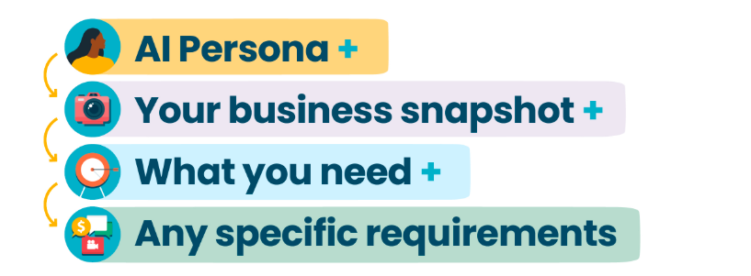
Writing Good Prompts
Resources:
5 Steps to Write Effective Prompts for AI
Notes:
Treating AI like a magic button:
- Owners expect perfect answers without providing context. AI works best when the owner provides goals, constraints, examples, and tone preferences.
Copy-pasting without editing:
- Leads to generic content, inconsistent brand voice, factual errors, and credibility issues. AI drafts; humans refine.
Using AI for specialized judgment:
- Examples: legal advice, tax guidance, HR compliance, medical or safety decisions. AI can summarize, explain, or prepare questions — but it cannot replace professionals.
Not protecting sensitive data:
- Owners sometimes paste customer lists, financial statements, proprietary formulas, and employee information. They need clear data-handling boundaries.
Over-automating before understanding the process:
- If the workflow is broken, AI just accelerates the chaos. Fix the process first.

Slide 12
Writing Good Prompts
Basic Prompt | Better Approach
Write me a product description for a wooden spoon: | I am small business owner who makes wooden kitchen products in my workshop and sells them internationally through my online store. Write me a product description under 75 words for a hand-made wooden spoon that highlights its utility, authenticity, and local sourcing. Make sure it sounds like it’s written in my voice. The tone should be friendly & down-to-earth like that of one cook speaking to another.
Resources:
5 Steps to Write Effective Prompts for AI
Notes:
Treating AI like a magic button:
- Owners expect perfect answers without providing context. AI works best when the owner provides goals, constraints, examples, and tone preferences.
Copy-pasting without editing:
- Leads to generic content, inconsistent brand voice, factual errors, and credibility issues. AI drafts; humans refine.
Using AI for specialized judgment:
- Examples: legal advice, tax guidance, HR compliance, medical or safety decisions. AI can summarize, explain, or prepare questions — but it cannot replace professionals.
Not protecting sensitive data:
- Owners sometimes paste customer lists, financial statements, proprietary formulas, and employee information. They need clear data-handling boundaries.
Over-automating before understanding the process:
- If the workflow is broken, AI just accelerates the chaos. Fix the process first.

Slide 13
Writing Good Prompts
Basic Prompt | Better Approach
Handcrafted Wooden Spoon – Timeless Simplicity Meets Everyday Function Bring natural warmth and durability to your kitchen with this beautifully handcrafted wooden spoon. Designed for both comfort and performance, it’s a versatile tool that makes everyday cooking feel a little more special. Key Features: Premium Hardwood Construction: Made from sustainably sourced, high-quality wood for exceptional strength and longevity. Smooth, Ergonomic Handle: Carefully shaped to fit comfortably in your hand, reducing fatigue during extended use. Gentle on Cookware: Safe for use with nonstick, ceramic, and stainless steel surfaces—no scratches, no damage. Heat Resistant & Durable: Won’t warp or melt like plastic, making it ideal for stirring hot soups, sauces, and sautéed dishes. Naturally Beautiful Grain: Each spoon features unique wood grain patterns, giving it a one-of-a-kind rustic charm. Why You’ll Love It: This wooden spoon blends form and function effortlessly. Whether you're mixing batter, stirring a simmering pot, or serving a homemade meal, it adds a touch of authenticity and craftsmanship…… | This is the kind of spoon I keep right by the stove. I make each one by hand from locally sourced wood, shaping it so it feels just right in your grip. It’s sturdy enough for everyday cooking and gentle on your cookware. Nothing fancy—just an honest, well-made spoon you’ll reach for again and again.
Notes:
Treating AI like a magic button:
- Owners expect perfect answers without providing context. AI works best when the owner provides goals, constraints, examples, and tone preferences.
Copy-pasting without editing:
- Leads to generic content, inconsistent brand voice, factual errors, and credibility issues. AI drafts; humans refine.
Using AI for specialized judgment:
- Examples: legal advice, tax guidance, HR compliance, medical or safety decisions. AI can summarize, explain, or prepare questions — but it cannot replace professionals.
Not protecting sensitive data:
- Owners sometimes paste customer lists, financial statements, proprietary formulas, and employee information. They need clear data-handling boundaries.
Over-automating before understanding the process:
- If the workflow is broken, AI just accelerates the chaos. Fix the process first.

Slide 14
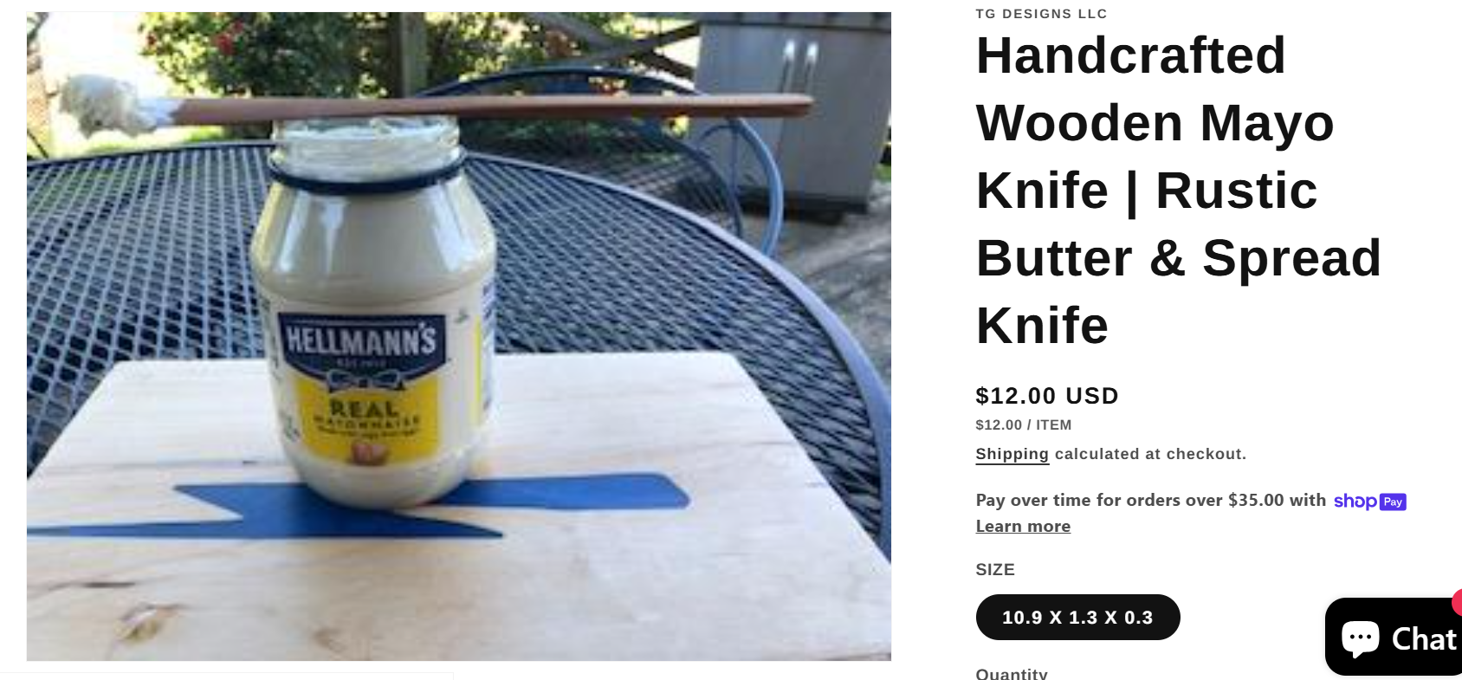
TG Designs Ex. 1
Handcrafted Wooden Mayo Knife | Rustic Butter & Spread Knife

Slide 15
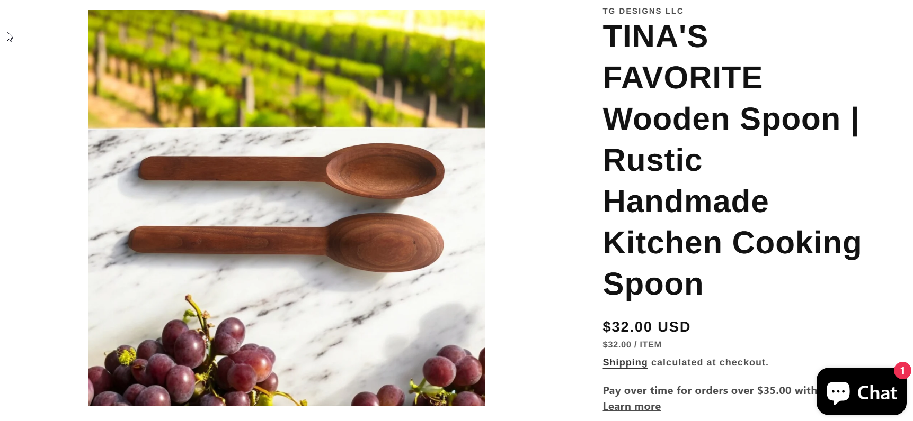
TG Designs Ex. 2
Product description:
Years ago, on Tina's first date with Gene, he showed up with a bundle of handcrafted gifts. One of those gifts was this beautifully crafted spoon. As Tina cooked with this spoon, she fell in love not only with it, but also with Gene. They were both keepers!
Bring warmth and tradition into your kitchen with the TINA'S FAVORITE Wooden Spoon — a timeless cooking essential….
TINA'S FAVORITE Wooden Spoon | Rustic Handmade Kitchen Cooking Spoon

Slide 16
Resources
Artificial Intelligence for Nonprofits (Custom Content)
AI Foundations for Your Business (Module)
Using AI Safely | Checking Content and Protecting Your Information
5 Steps to Write Effective Prompts for AI
AI | What It Is & How You Can Use It
AI Productivity & Cyber Security for Small Businesses (Learn with an Expert Series) (Custom Content)

Slide 17
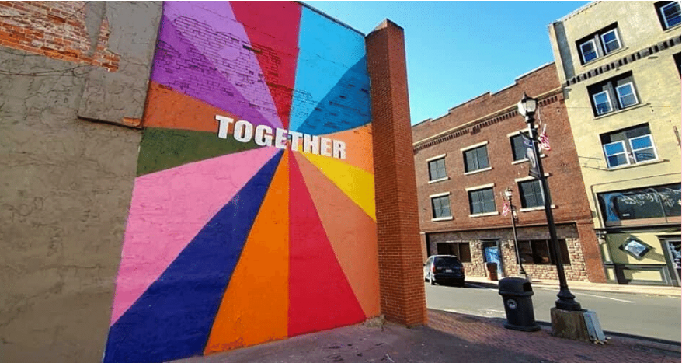
Any Questions or Comments?
Mountain Association sponsored mural in Hazard, KY
Notes:
Bailey

